Slide 1
Language Models are Few-Shot Learners
CSCI-B 659 Advanced Natural Language Processing
Hardik Asnani
Anisha Bajaj
Umesh Kumar
Shreyas Vaidya
Arpita Welling
INDIANA UNIVERSITY BLOOMINGTON

Slide 2
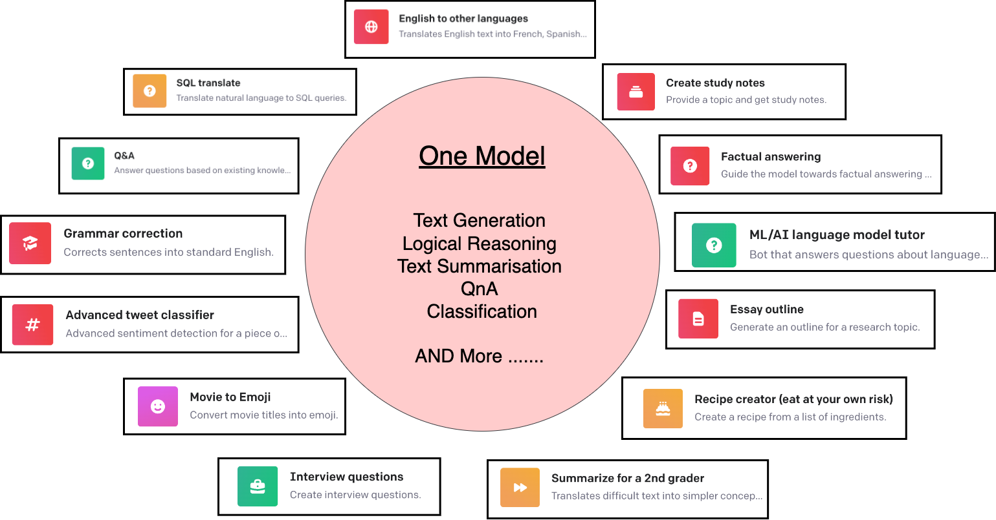
One ring to rule them all

Slide 3
Let’s Play!
SECTION 1

Slide 4
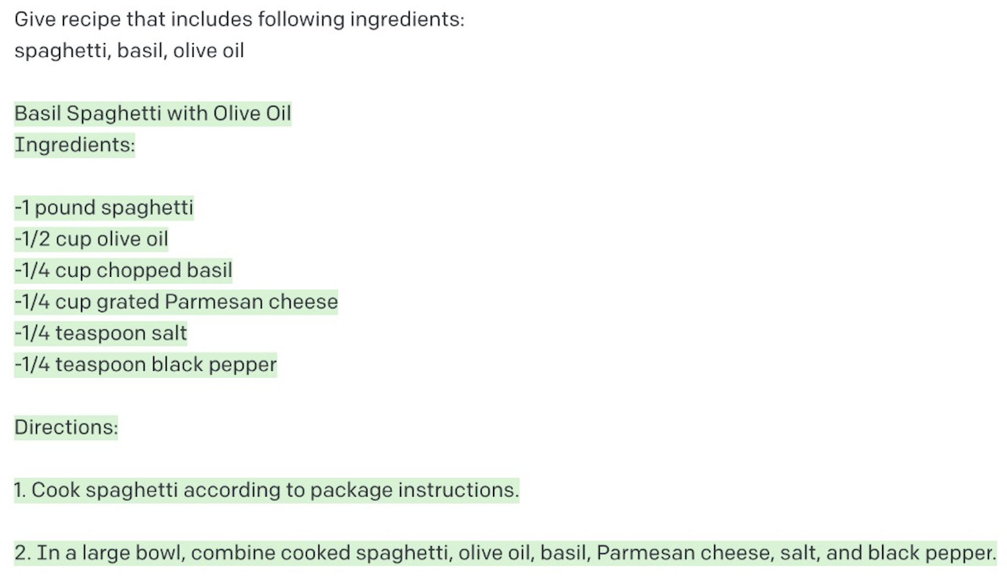
Examples
Render HTML Layout
Arpita’s Cooking Recipe
Render HTML output
https://twitter.com/i/status/1282676454690451457
Arpita’s Cooking Recipe

Slide 5
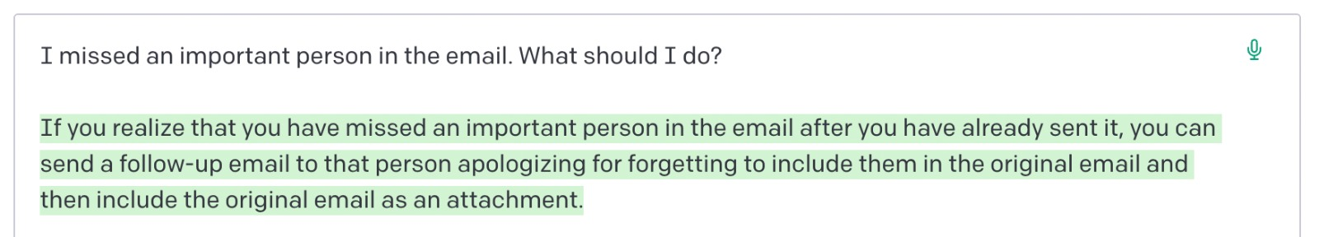
Examples
Hardik’s Dilemma:
Activity : Names Meaning Prediction

Slide 6
Why GPT3?
SECTION 2

Slide 7
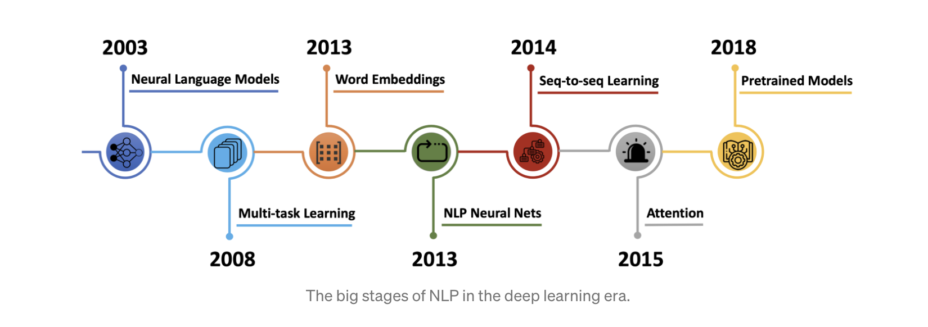
Language Model Evolution

Slide 8
GPT3 v/s the rest
State of the art architectures are task agnostic but require task-specific data
Need Labeled examples – Time intensive hand labeling
Difficult to get large supervised train set
Repeated for every task
Lack of fluidity and scalability
GPT3 eliminates all of this - few shot learning
No fine tuning
Little human supervision

Slide 9
What’s GPT3?
SECTION 3

Slide 10
Some Basics - Language Models
What - Statistical and probabilistic techniques determine the probability of a given sequence of words
Where - Linguistic Applications - Speech Recognition, OCR (Optical Character Recognition), code generation, and many more
Example - Unigrams, Bigrams, Bidirectional Encoder Representation, Transformers Models.

Slide 11
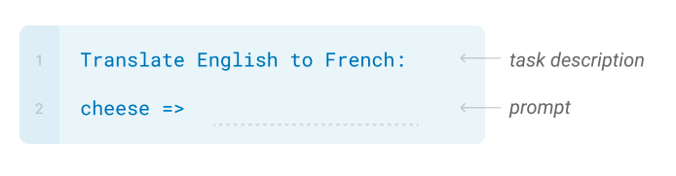
Zero-shot
Requires no examples
Little Human Intervention
Models depends on historical trained concepts and data
Example:

Slide 12
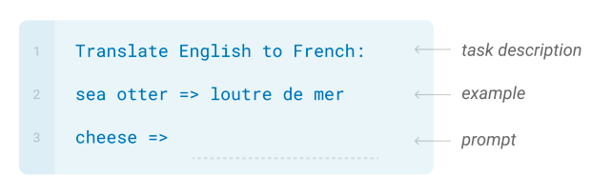
One Shot
Exactly as the name suggest
Single example per task description
Example:

Slide 13
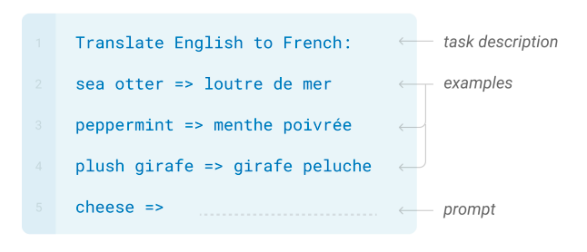
Few Shots
Provide few examples for the task description to predict the output
10 - 100 examples can fit the context window
Reduction in the need for task-specific data
Example:

Slide 14
GPT3 Architecture
SECTION 4

Slide 15
GPT3
Generative Pre-trained Transformer 3
Released in June 2020, claimed to largest one in terms of params and storage
Autoregressive Language Model
Meta Learning, In-context Learning
Uses Deep Learning for Natural Language Tasks (like text classification, machine translation, Q&A)
Human like Text Output
Performs tasks using all, Zero Shot, One Shot and Few Shots.

Slide 16
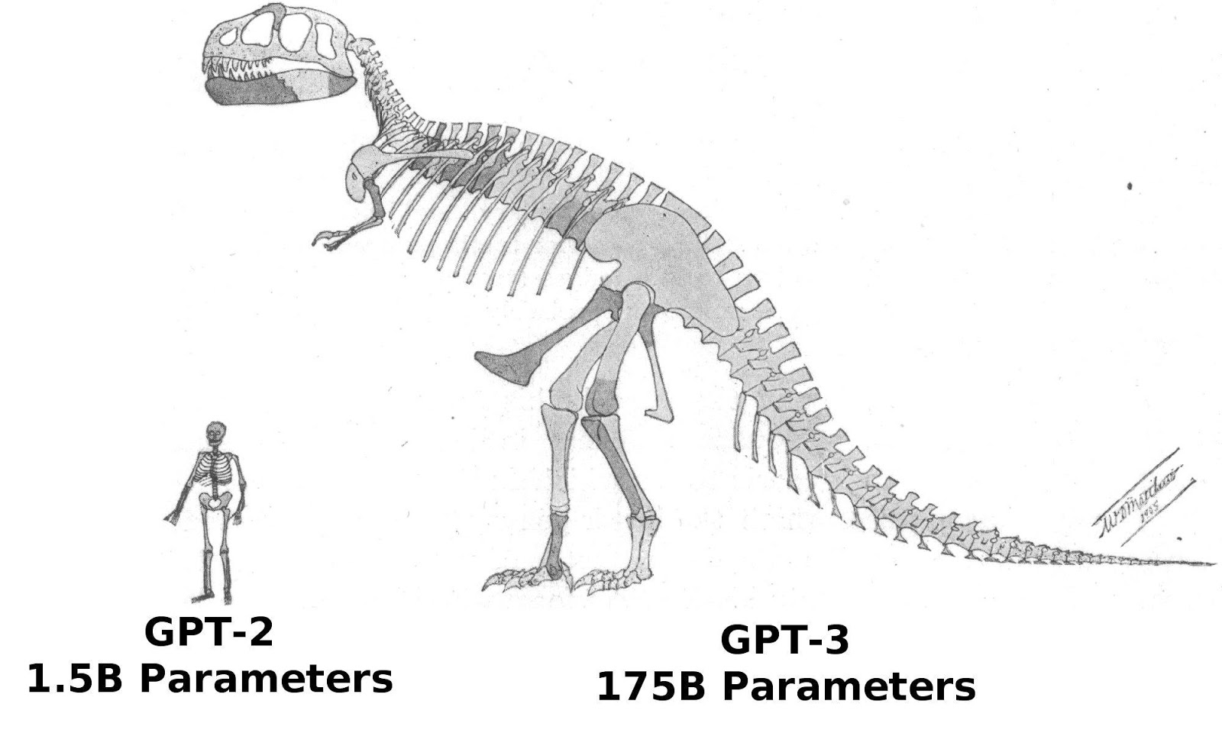
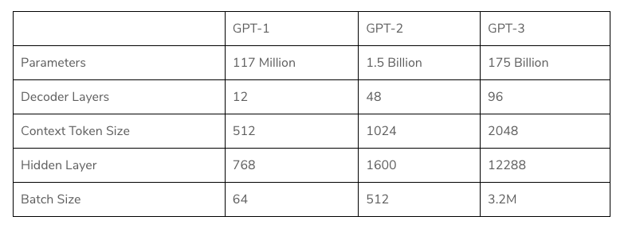
What’s 3 doing in GPT3?

Slide 17
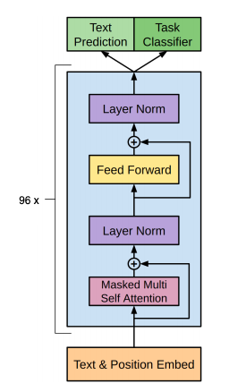
Architecture
GPT 3 Model consists of following layers
Input Embeddings
Positional Embeddings
MultiHead Attention
Normalisation
Feed Forward Layers
Softmax

Slide 18
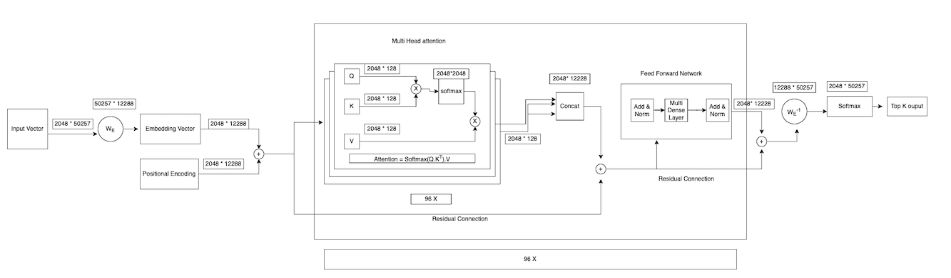
GPT3 Model Architecture

Slide 19
GPT3 Model
GPT3 model was trained on vocabulary of 50257 words
The input sequence is actually fixed to 2048 words.
If the input is less than 2048 words, it will pad with 0’s.
The output sequence is also fixed to 2048 words.
GPT3 uses the embedding dimensions of 12288 dimensions.
Embedding dimensions are nothing but the features of the input like “softness”, “color”, “past tense”, “numerical” etc..

Slide 20
Approach
SECTION 5

Slide 21
Data
Common Crawl Dataset
Downloaded from 41 shards of monthly covering from 2016-19
45TB of plain text before filtering, 570GB after that
400 billion byte-paired encoded tokens

Slide 22
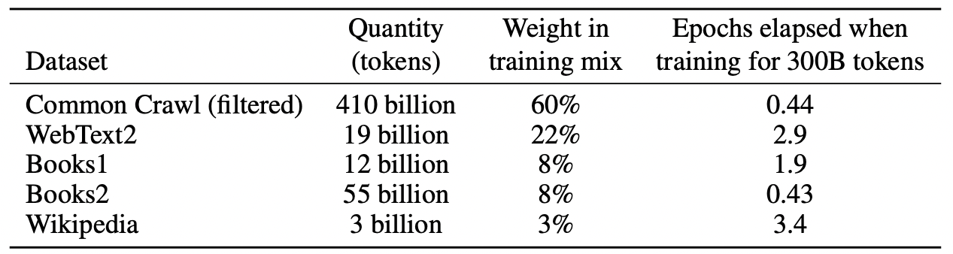
Data Preprocessing
Filtered based on similarity to range of high-quality corpora
Fuzzy de-duplication at document level to prevent redundancy
Sampling and Augmentation - Addition of other datasets – increased diversity
Higher quality datasets sampled more frequently

Slide 23
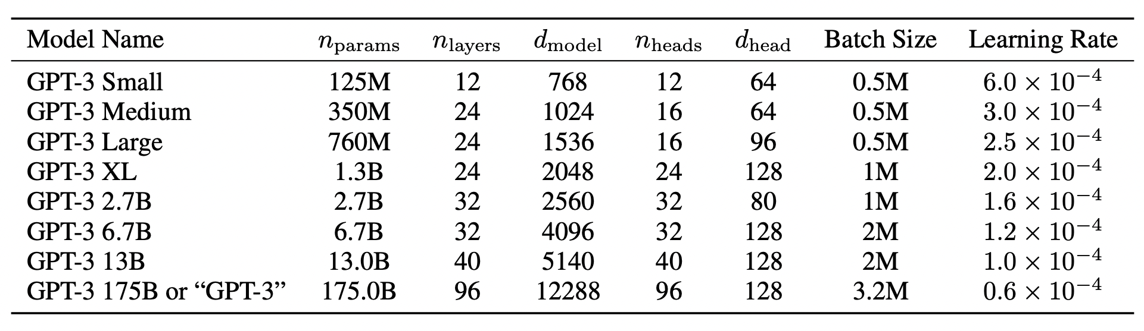
Training
Large models might go out of memory - Parallelism in matrix multiplication
Used Gradient Noise Scale to determine batch size
V100 GPU’s - high bandwidth cluster by Microsoft
Adam with cosine decay for Learning Rate

Slide 24
Evaluation
Randomly draw K samples from training as conditioning for few-shots
Maximum size of k depends on matrix window (2048)
Typically fits 0 to 100 examples
Evaluation is Task specific
For example, for MCQ’s, K samples of context + completion with 1 of context only. Then compare LM likelihood of each completion
Another eg, for free-form completion tasks, beam search is used with score using F1 similarity score, BLEU, or exact match based on data
Evaluated 8 models - 175B GPT3 + 7 smaller models

Slide 25
Results
Results of various datasets grouped into 9 task-specific categories
Examples:
Language Models
Translation
Reading Comprehension

Slide 26
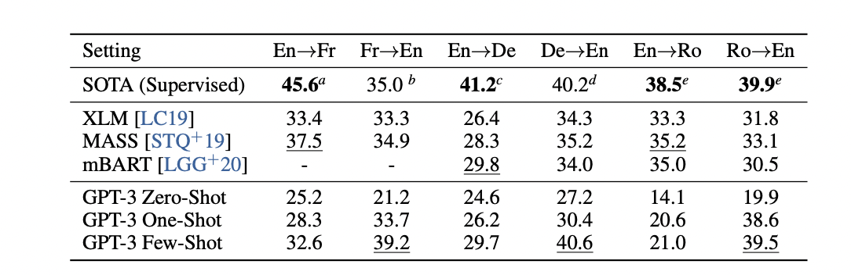
Results - Language Translation
GPT-3 Few shot gives similar average performance with SOTA while translating to English
Significant improvement from unsupervised models while translating to English
Better BLEU score accuracy with increase in number of shots

Slide 27
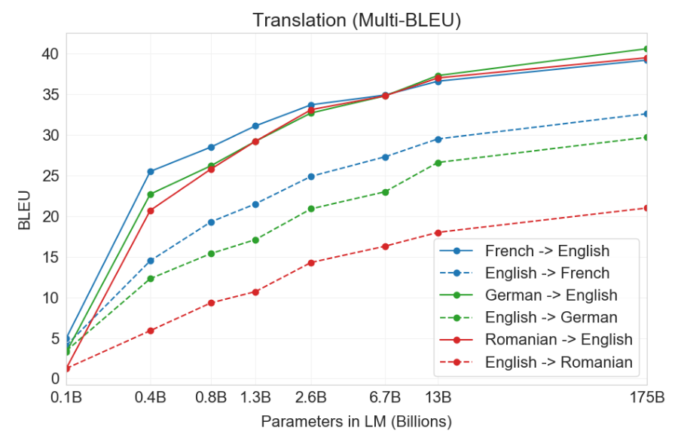
Results - Language Translation
Improvement in BLEU score across different model capacity for all translation tasks

Slide 28
Nothing’s Perfect
SECTION 6

Slide 29
Limitations
Text Synthesis - Loses coherence, predictions contradict themselves
Limited Input and Output Size
Underperforms in case of bidirectional use cases
Eg: Fill in the blanks, Reading comprehension
Pre-training limitations with scaling
Weighs tokens equally, lack of world context
Is it really adaptive?
Bias from data, non-interpretable
And yes, it’s expensive, large, inconvenient….

Slide 30
Future Work
Improve pre-training, sample efficiency
How exactly few shots learning works?
Distillation to sized specific tasks
GPT4 expected to come by end of this year!

Slide 31
Broader Impacts
Misinformation, spam, phishing, legal abuse, social engineering pretexting
GPT3 can generate text indistinguishable from human-written ones.
Enabling Threat actors
Bias in Data
Generates prejudiced content, (Gender, Race, Religion)
May result in demeaning portrayal
Energy usage
Also, Hardik misuses GPT3 a lot!

Slide 32
Fun Facts
In one study, GPT-3 was able to generate “news articles” almost indistinguishable from human-made pieces. Judges barely achieved above-chance accuracy (52%) at correctly classifying GPT-3 texts.
GPT-3 has an artist’s soul! Arram Sabeti told GPT-3 to write a poem about Elon Musk by Dr. Seuss and a rap song about Harry Potter by Lil Wayne.
GPT3 can also generate PowerPoint presentations!
(Though this presentation is solely prepared by us, hope you believe it :))

Slide 33
Questions?
- Ask GPT3!

Slide 34
Practical
SECTION 7

Slide 35
Task 1
Study the Impact of GPT3 Parameters on Classification Accuracy
Few shot learning
Twitter Sentiment Classification
Plot Accuracy Scores vs Parameters
Parameters
Engine Type
Temperature
Token Length

Slide 36
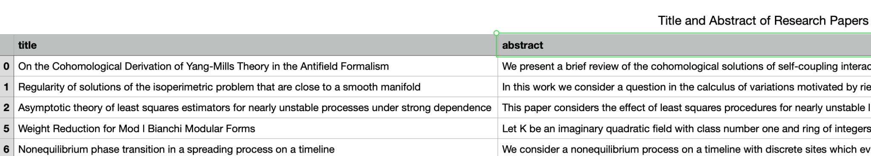
Task 2
Given the abstract of a research paper, generate it's title
Feeding examples to GPT-3
Zero/Few Shots
BLEU Score
Plot
Learnings
Dataset

Slide 37
Task 3
By this task we will learn how GPT3 perform better than any SOTA models by comparing the performance of GPT3 with any fine-tuning Language Model.
For our ease, let’s take the reference of our last practical Seq_to_Seq translation use case.
Let’s solve the problem using the Bahdinau_Attention fine-tuning model and solve the same using the GPT3 and compare the metrics and results.

Slide 38
Things to Explore
Openai Playground - https://beta.openai.com/playground
GPT3 Github Repo - https://github.com/elyase/awesome-gpt3

Slide 39
References
GPT3 Paper - https://arxiv.org/pdf/2005.14165.pdf
https://www.datacamp.com/blog/a-beginners-guide-to-gpt-3
https://dugas.ch/artificial_curiosity/GPT_architecture.html
https://towardsdatascience.com/gpt-3-a-complete-overview-190232eb25fd
https://medium.com/walmartglobaltech/the-journey-of-open-ai-gpt-models-32d95b7b7fb2

Slide 40
THANK YOU

